Slide 1
Introduction

Slide 2
Lesson Objectives
After completing this lesson, you should be able to do the following:
  Discuss the goals of the course
  Describe the HR database schema that is used in the course
  Identify the available user interface environments that can be used in this course
  Reference the available appendixes, documentation, and other resources
Notes:
This lesson gives you a high-level overview of the course and its flow. You learn about the database schema and the tables that the course uses. The course introduces you to components such as SQL, PL/SQL, compilation features and also tools such as SQL Developer used in this course.
Oracle Database: PL/SQL Fundamentals 1 - <number>

Slide 3
Course Objectives
After completing this course, you should be able to do the following:
  Identify the programming extensions that PL/SQL provides to SQL
  Write PL/SQL code to interface with the database
  Design PL/SQL anonymous blocks that execute efficiently
  Use PL/SQL programming constructs and conditional control statements
  Handle run-time errors
  Describe stored procedures and functions
Notes:
This course presents the basics of PL/SQL. You learn about PL/SQL syntax, blocks, and programming constructs and also about the advantages of integrating SQL with those constructs. You learn how to write PL/SQL program units and execute them efficiently. In addition, you learn how to use SQL Developer as a development environment for PL/SQL. You also learn how to design reusable program units such as procedures and functions.
Oracle Database: PL/SQL Fundamentals 1 - <number>

Slide 4
Human Resources (HR) Schema for This Course
DEPARTMENTS
department_id
department_name
manager_id
location_id
LOCATIONS
location_id
street_address
postal_code
city
state_province
country_id
JOB_HISTORY
employee_id
start_date
end_date
job_id
department_id
EMPLOYEES
employee_id
first_name
last_name
email
phone_number
hire_date
job_id
salary
commission_pct
manager_id
department_id
COUNTRIES
country_id
country_name
region_id
JOBS
job_id
job_title
min_salary
max_salary
REGIONS
region_id
region_name
Notes:
The Human Resources (HR) schema is part of the Oracle Sample Schemas that can be installed in an Oracle database. The practice sessions in this course use data from the HR schema.
Table Descriptions
REGIONS contains rows that represent a region such as the Americas or Asia.
COUNTRIES contains rows for countries, each of which is associated with a region.
LOCATIONS contains the specific address of a specific office, warehouse, or production site of a company in a particular country.
DEPARTMENTS shows details about the departments in which employees work. Each department may have a relationship representing the department manager in the EMPLOYEES table.
EMPLOYEES contains details about each employee working for a department. Some employees may not be assigned to any department.
JOBS contains the job types that can be held by each employee.
JOB_HISTORY contains the job history of the employees. If an employee changes departments within a job or changes jobs within a department, a new row is inserted into this table with the old job information of the employee.
Oracle Database: PL/SQL Fundamentals 1 - <number>

Slide 5
Course Agenda
  Day 1:
    Introduction
    Introduction to PL/SQL
  Day 2:
    Declaring PL/SQL Variables
  Day 3:
    Writing Executable Statements
  Day 4:
    Interacting with Oracle Database Server: SQL Statements in PL/SQL Programs
  Day 5:
    Midterm Exam (30 puntos)
Notes:
Oracle Database: PL/SQL Fundamentals 1 - <number>

Slide 6
Course Agenda
  Day 6:
    Writing Control Structures
    Working with Composite Data Types
  Day 7:
    Using Explicit Cursors
  Day 8:
    Handling Exceptions
  Day 9:
    Introducing Stored Procedures and Functions
  Day 10:
    Final Exam (30 puntos)
Notes:
Oracle Database: PL/SQL Fundamentals 1 - <number>

Slide 7

Class Account Information
  A cloned HR account ID is set up for you.
  Your account ID is ora41.
  The password matches your account ID.
  Each machine has its own complete environment, and is assigned the same account.
  The instructor has a separate ID.
Notes:
Oracle Database: PL/SQL Fundamentals 1 - <number>

Slide 8
Appendixes and Practices Used in This Course
  Appendix A: Table Descriptions and Data
  Appendix B: Using SQL Developer
  Appendix C: Using SQL*Plus
  Appendix D: Using JDeveloper
  Appendix E: REF Cursors
  Activity Guide: Practices and Solutions
Notes:
Oracle Database: PL/SQL Fundamentals 1 - <number>

Slide 9
PL/SQL Development Environments
This course setup provides the following tools for developing PL/SQL code:
  Oracle SQL Developer (used in this course)
  Oracle SQL*Plus
  Oracle JDeveloper IDE
Notes:
Oracle provides several tools that can be used to write PL/SQL code. Some of the development tools that are available for use in this course:
Oracle SQL Developer: A graphical tool
Oracle SQL*Plus: A window or command-line application
Oracle JDeveloper: A window-based integrated development environment (IDE)
Note: The code and screen examples presented in the course notes were generated from output in the SQL Developer environment.
Oracle Database: PL/SQL Fundamentals 1 - <number>

Slide 10

What Is Oracle SQL Developer?
  Oracle SQL Developer is a free graphical tool that enhances productivity and simplifies database development tasks.
  You can connect to any target Oracle database schema using standard Oracle database authentication.
  You will use SQL Developer in this course.
  Appendix C contains details on using SQL Developer.
SQL Developer
Notes:
Oracle SQL Developer is a free graphical tool designed to improve your productivity and simplify the development of everyday database tasks. With just a few clicks, you can easily create and maintain stored procedures, test SQL statements, and view optimizer plans.
SQL Developer, the visual tool for database development, simplifies the following tasks:
Browsing and managing database objects
Executing SQL statements and scripts
Editing and debugging PL/SQL statements
Creating reports
You can connect to any target Oracle database schema by using standard Oracle database authentication. When you are connected, you can perform operations on objects in the database.
Appendix B
Appendix B of this course provides an introduction on using the SQL Developer interface. Refer to the appendix for information about creating a database connection, interacting with data using SQL and PL/SQL, and more.
Oracle Database: PL/SQL Fundamentals 1 - <number>

Slide 11
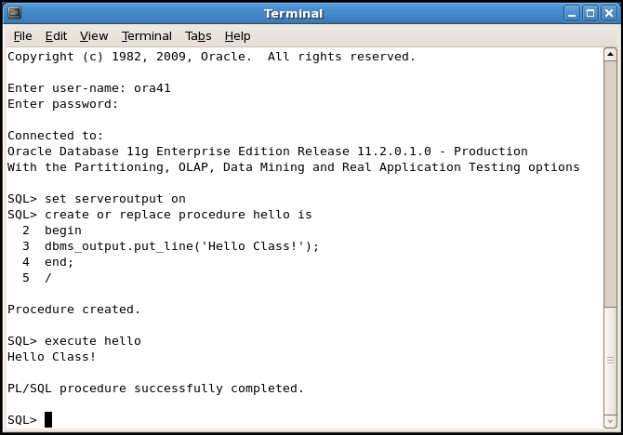

Coding PL/SQL in SQL*Plus
Notes:
Oracle SQL*Plus is a command-line interface that enables you to submit SQL statements and PL/SQL blocks for execution and receive the results in an application or a command window.
SQL*Plus is:
Shipped with the database
Installed on a client and on the database server system
Accessed using an icon or the command line
When you code PL/SQL subprograms using SQL*Plus, remember the following:
You create subprograms by using the CREATE SQL statement.
You execute subprograms by using either an anonymous PL/SQL block or the EXECUTE command.
If you use the DBMS_OUTPUT package procedures to print text to the screen, you must first execute the SET SERVEROUTPUT ON command in your session.
Note
To launch SQL*Plus in Linux environment, open a Terminal window and enter the command: sqlplus.
For more information about using SQL*Plus, see Appendix C.
Oracle Database: PL/SQL Fundamentals 1 - <number>

Slide 12
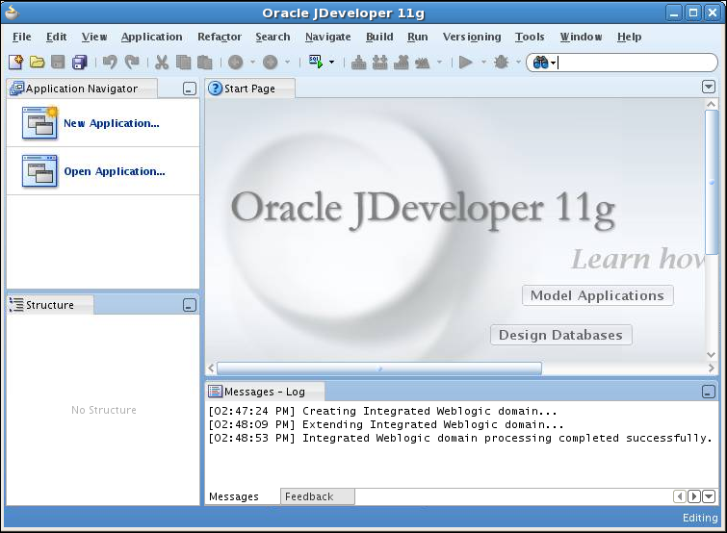
Coding PL/SQL in Oracle JDeveloper
Notes:
Oracle JDeveloper allows developers to create, edit, test, and debug PL/SQL code by using a sophisticated GUI. Oracle JDeveloper is a part of Oracle Developer Suite and is also available as a separate product.
When you code PL/SQL in JDeveloper, consider the following:
You first create a database connection to enable JDeveloper to access a database schema owner for the subprograms.
You can then use the JDeveloper context menus on the Database connection to create a new subprogram construct using the built-in JDeveloper Code Editor.
You invoke a subprogram by using a Run command on the context menu for the named subprogram. The output appears in the JDeveloper Log Message window, as shown in the lower portion of the screenshot.
Note
JDeveloper provides color-coding syntax in the JDeveloper Code Editor and is sensitive to PL/SQL language constructs and statements.
For more information about using JDeveloper, see Appendix D.
Oracle Database: PL/SQL Fundamentals 1 - <number>

Slide 13
Oracle SQL and PL/SQL Documentation
  Oracle Database New Features Guide
  Oracle Database PL/SQL Language Reference
  Oracle Database Reference
  Oracle Database SQL Language Reference
  Oracle Database Concepts
  Oracle Database PL/SQL Packages and Types Reference
  Oracle Database Advanced Application Developer’s Guide 11g
  Oracle Database SQL Developer User’s Guide Release 3.1
Notes:
Navigate to http://www.oracle.com/pls/db112/homepage to access the Oracle Database 11g documentation library.
Navigate to http://www.oracle.com/pls/db102/homepage to access the Oracle Database 10g documentation library.
Oracle Database: PL/SQL Fundamentals 1 - <number>

Slide 14
Summary
In this lesson, you should have learned how to:
  Discuss the goals of the course
  Describe the HR database schema that is used in the course
  Identify the available user interface environments that can be used in this course
  Reference the available appendixes, documentation, and other resources
Notes:
Oracle Database: PL/SQL Fundamentals 1 - <number>

Slide 15
Practice 1 Overview: Getting Started
This practice covers the following topics:
  Starting SQL Developer
  Creating a new database connection
  Browsing the HR schema tables
  Setting a SQL Developer preference
Notes:
In this practice, you use SQL Developer to execute SQL statements to examine data in the HR schema. You also create a simple anonymous block.
Note: All written practices use SQL Developer as the development environment. Although it is recommended that you use SQL Developer, you can also use the SQL*Plus or JDeveloper environments that are available in this course.
Oracle Database: PL/SQL Fundamentals 1 - <number>

